Slide 1
Passenger Reroute: Phone-Based Intervention In Self-Driving Cars
Bachelor Thesis
Vincent Göke
21. Dezember 2021
Wissenschaftliche Betreuerin:
Jingyi Li
Verantwortlicher Professor:
Prof. Dr. Andreas Butz

Slide 2
Presentation Outline
Introduction
Related Work
Research Questions
Concept
Implementation
Main Study
Results
Conclusion

Slide 3
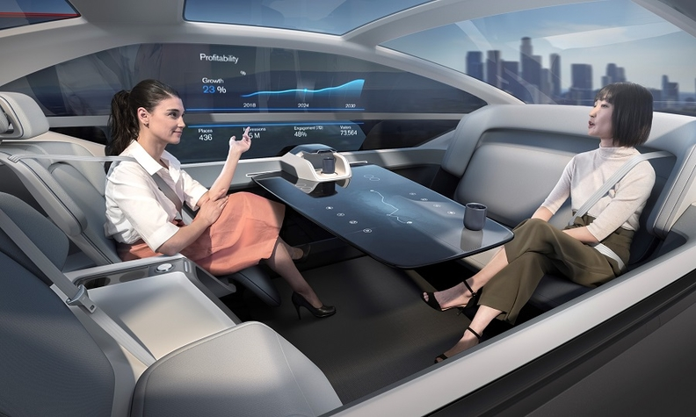
1. Introduction
In autonomous vehicles (AV) passengers could…
…engage in non-driving related activities (NDRA)
…react to non-critital spontaneous situations (NCSS)
Papersource: https://link.springer.com/article/10.1007/s42154-019-00087-9
Terken, 2020; Toward Shared Control Between Automated Vehicles and Users
Papersource: https://doi-org.emedien.ub.uni-muenchen.de/10.1145/3409120.3410652
Wang, 2020; “Watch out!”: Prediction-Level Intervention for Automated Driving
Source: https://s3-prod-europe.autonews.com/s3fs-public/Volvo%20AV.jpg
Notes:
-passengers of self-driving cars have the freedom to pursue new activities mid-drive
-Passenger UX differentiates from conventional driver UX
-manual driving being replaced by autonomous driving-systems is a big step and requires a transparent and efficient communication between system and user for it to be accepted and used by the broader public.
-improvement of the passenger experience and conditions for acceptance of the system
-provide the freedom to confidently react to spontaneous

Slide 4
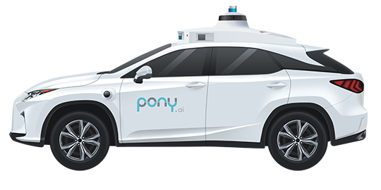
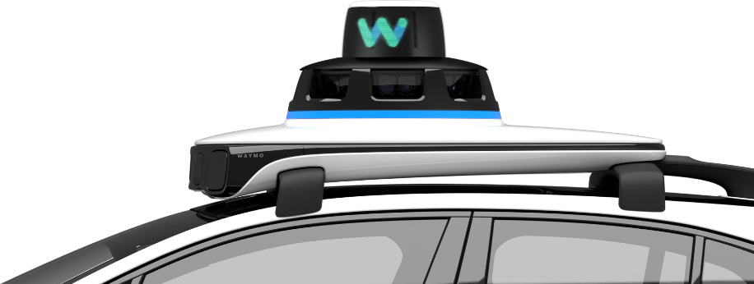
1. Introduction
Travel with AVs
No driver/ steeringwheel
New IT-> Trust issues
Individual expectations for information displayment
Need for safety, autonomy
Pony.ai Car: https://static.cdn.xiaomazhixing.com/images/home/car_1615998576.png
Waymo Sensors and Camera: https://static.cdn.xiaomazhixing.com/images/home/car_1615998576.png
Mercedes LVL 3 source: https://auto.hindustantimes.com/auto/news/mercedesbenz-becomes-world-s-first-to-get-level-3-autonomous-driving-approval-41639196499051.html
Notes:
SAE Levels:
Level 0: No Automation.
Level 1: Assisted Driving Automation.
Level 2: Partial Automation.
Level 3: Conditional Automation.
Level 4: High Automation.
Level 5: Full Automation.
Technical Aspect:
-age of ubiquitous computing
-multiple sensors and cameras process real-time information about their environment (monitored by in-car UI)
LiDAR (Light detection and ranging) -> speed and distance
-technological development of autonomous vehicles progresses towards broader testing
-UN-R157 United Nations regulation body for Level 3 automation standard
-Selection of silicon valley companies that currently develop self-driving cars
-some companies already test driverless systems in public spaces
self-driving systems in clearly structured and urban street areas
Tesla
Waymo (google)
Pony.ai
Zoox

Slide 5
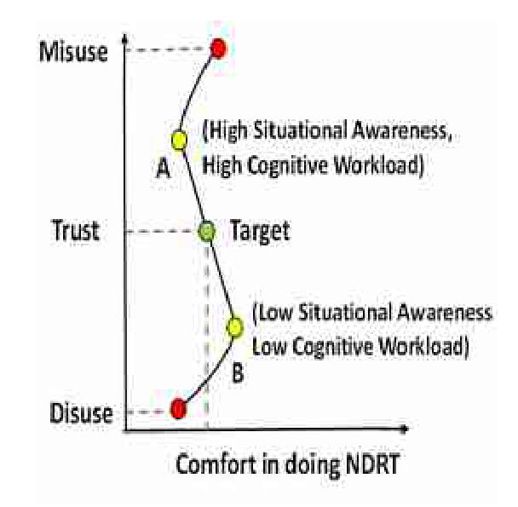

2. Related Work – NDRA vs. Trust
Tradeoff in AVs: comfortability of NDRA and the perceived trustworthiness of the car
Imbalanced UIs might cause Mis- or even Disuse
Paper source: https://dl.acm.org/doi/10.1145/3004323.3004331
Miglani, Diels - Compatibility between Trust and Non - Driving Related Tasks in UI Design for Highly and Fully Automated Driving

Slide 6
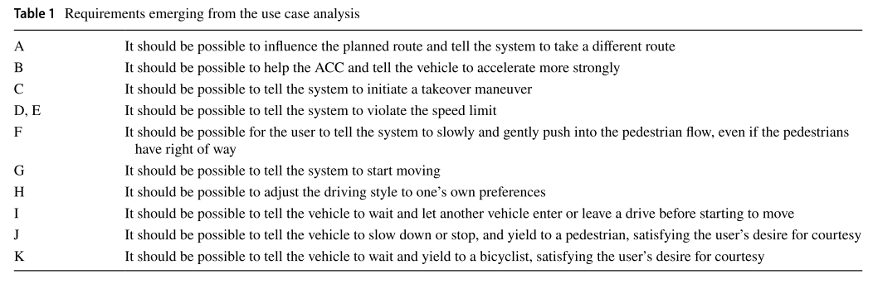
2. Related Work– Use cases
Papersource: https://link.springer.com/article/10.1007/s42154-019-00087-9
Terken, 2020; Toward Shared Control Between Automated Vehicles and Users

Slide 7
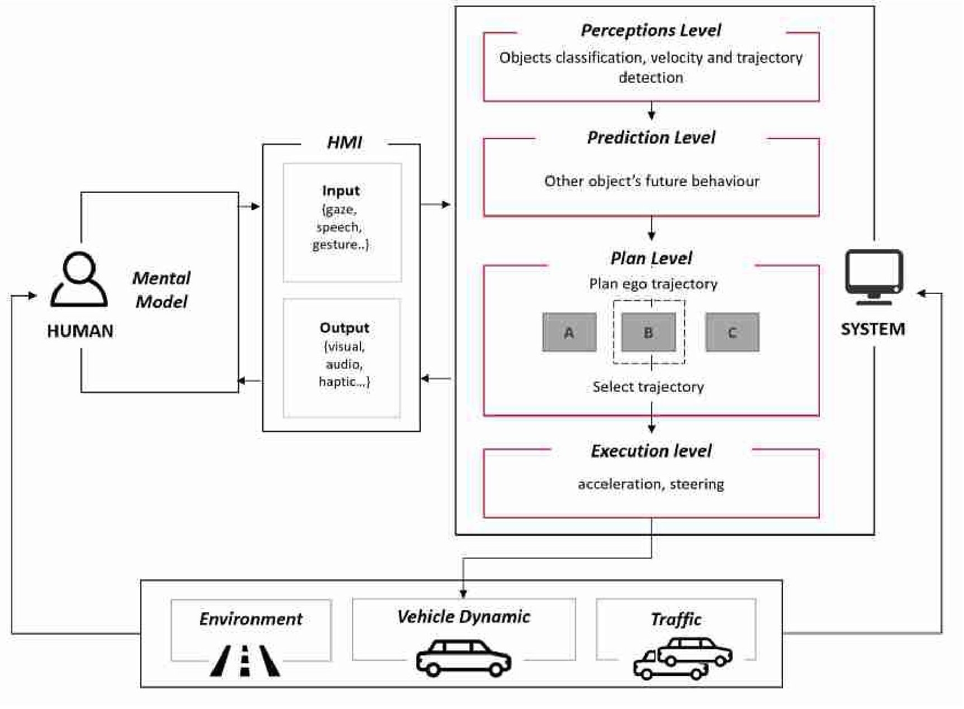
2. Related Work– AV Framework
Papersource: https://doi-org.emedien.ub.uni-muenchen.de/10.1145/3409120.3410652
Wang, 2020; “Watch out!”: Prediction-Level Intervention for Automated Driving

Slide 8
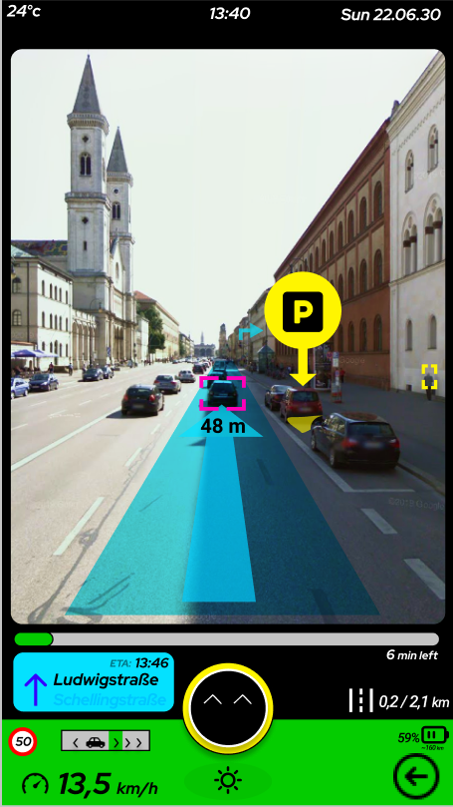
2. Related Work – Measurement
What factors establish trust?
Important factors of UIs fostering user trust
Anthropomorphism
Transparency
System perceived as an expert (by neatness/ aesthetics)
Customization of noncritical information
Brand reputation
System knowledge and experience
Early design , all information
Paper source: https://dl.acm.org/doi/abs/10.1145/3004323.3004331,
Diels, Migliani 2016 - Compatibility between Trust and Non - Driving Related Tasks in UI Design for Highly and Fully Automated Driving
Source: https://www.google.de/maps/@48.1502068,11.5810582,3a,75y,199.03h,89.64t/data=!3m7!1e1!3m5!1s0xWceYKdW_QNjH9PVLU75w!2e0!6shttps:%2F%2Fstreetviewpixels-pa.googleapis.com%2Fv1%2Fthumbnail%3Fpanoid%3D0xWceYKdW_QNjH9PVLU75w%26cb_client%3Dmaps_sv.tactile.gps%26w%3D203%26h%3D100%26yaw%3D350.58984%26pitch%3D0%26thumbfov%3D100!7i13312!8i6656
Notes:
Anthropomorphism (smiley, communication)
Transparency (trajectory indication, next street name)
System perceived as an expert (by neatness/ aesthetics) (Overall UX, final interview feedback)
Customization of noncritical information (different levels to test which one is perceived good)
Brand reputation (not possible to test here)
System knowledge and experience (Interview feedback, levels are similar in their task completion)

Slide 9
3. Research Questions
RQ1: How do varying amounts of information in an AV navigation UI affect passenger‘s UX, cooperative performance and trust in the system? Is the time restraint relevant?
RQ2: How much information is adequate for navigation level AV UIs?

Slide 10
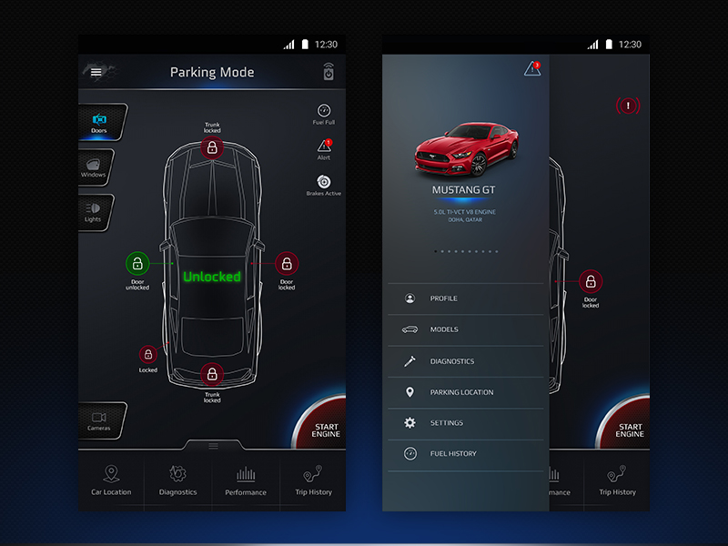
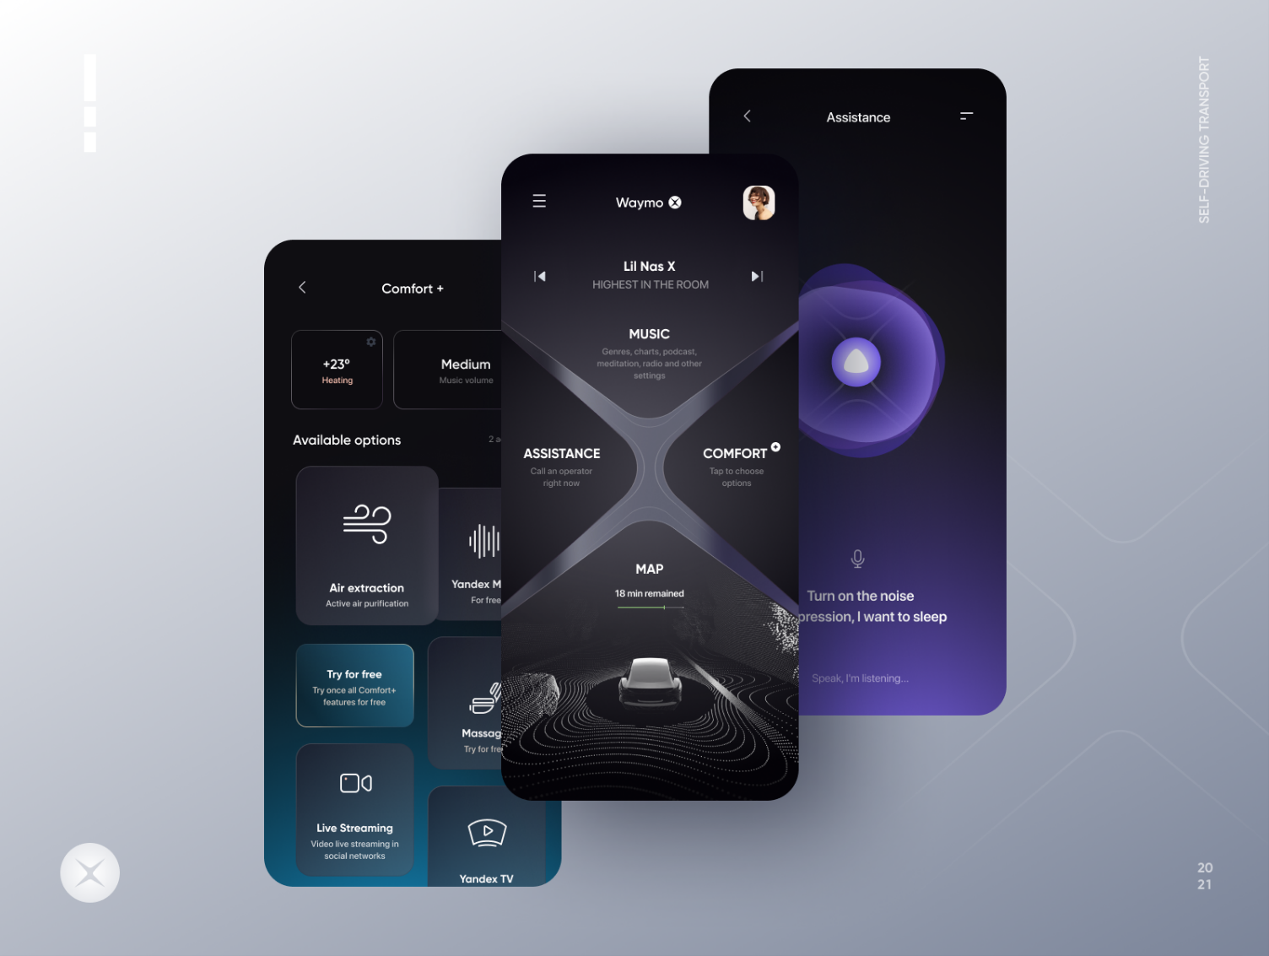
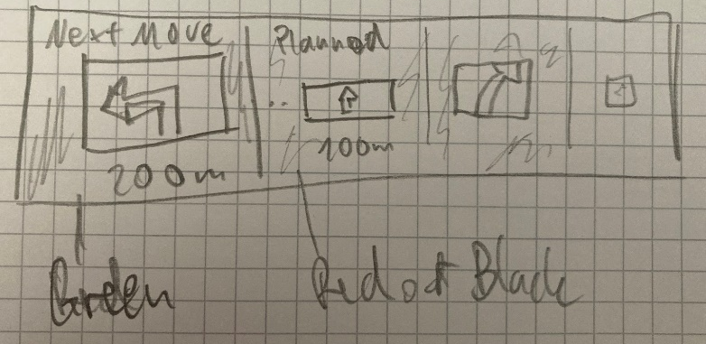
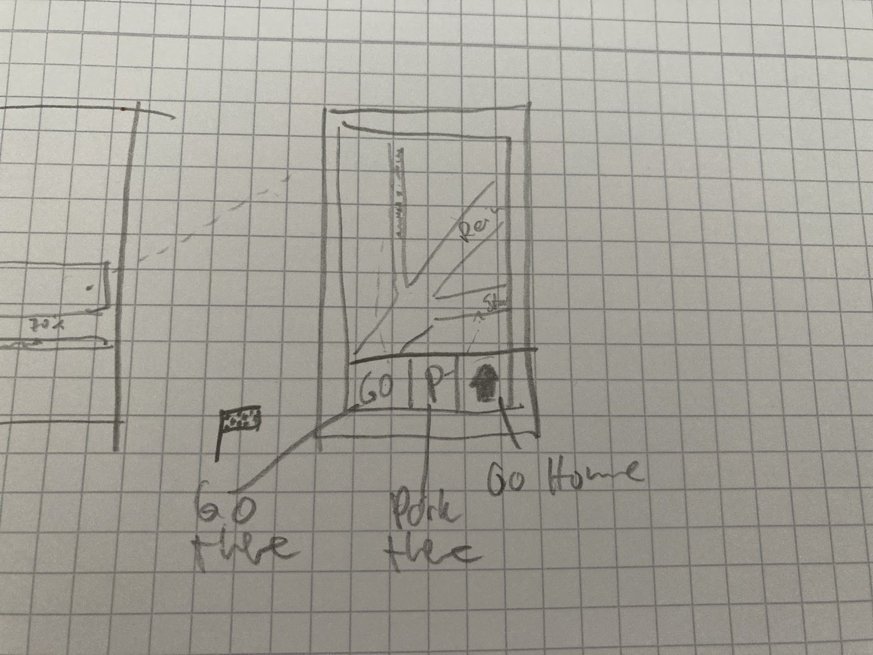
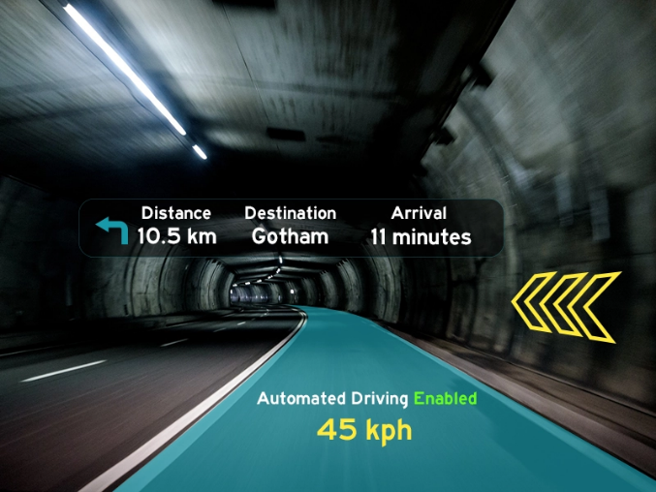
4. Concept - Inspiration
Source: top left: https://www.pinterest.com/pin/27795722678420817/
Source: top right: https://dribbble.com/shots/14803142-Self-driving-Taxi-App
Source: bottom: https://dribbble.com/shots/4012484-Automated-Driving-UI
Notes:
Insert ref

Slide 11
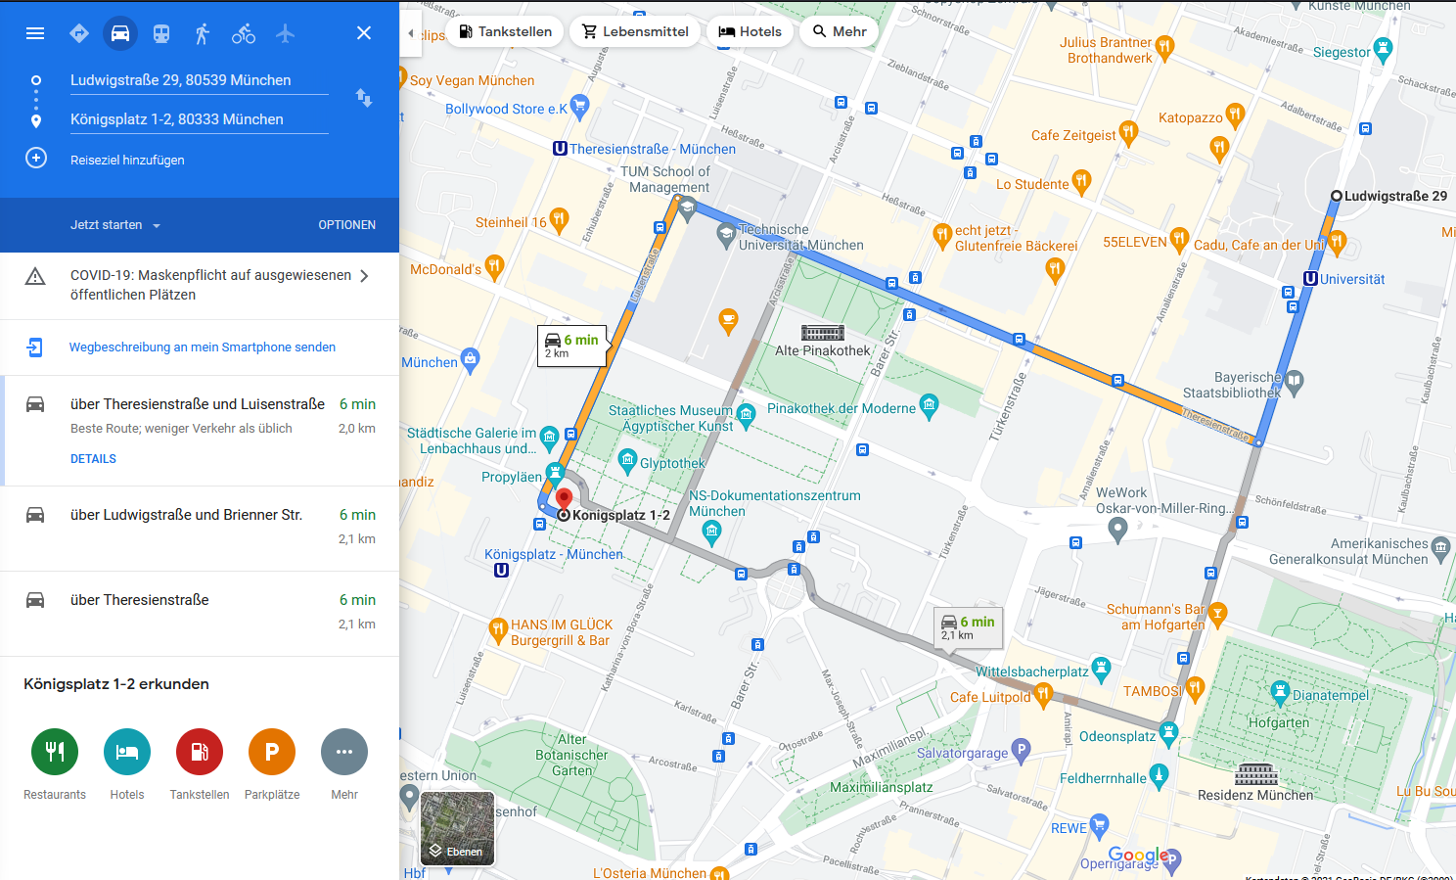
4. Concept – Preset Route
Source: https://www.google.de/maps/dir/48.1504449,11.5812516/48.1457715,11.5642941/@48.1475748,11.5681677,16z/data=!3m1!4b1!4m2!4m1!3e0
Notes:
-selecting a intermediate stop on a map application while moving -> stressful experience
-preselection according to users preference (staged in scenario) and favourite locations for specific stop causes can speed up the decisional process and increases overall trust of passengers in the AV

Slide 12
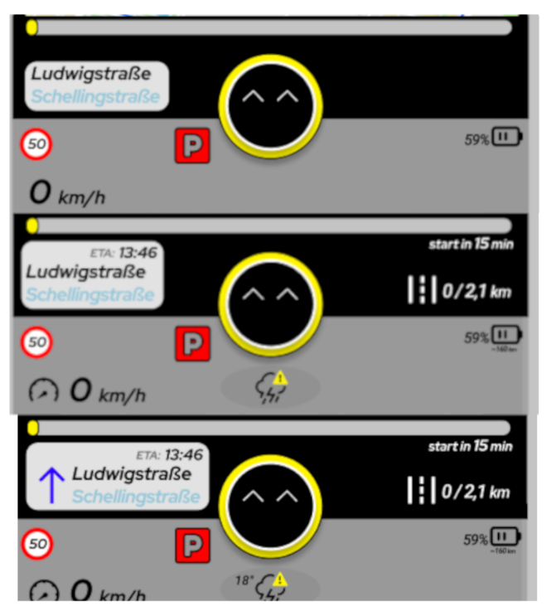
4. Concept – Pilot Study
Purpose:
Test design frames for viability
Functionalities and aesthetics, useful and necessary?
Is any information missing?
Can something be left out?
Details:
N=11 participants
Limesurvey
Personal interview
Bottom menu
Notes:
Three wireframe screens planned:
Home screen () General Car information (speed, braking or accelerating, gas/ battery status,
Navigation screen () Big map with preset route, two shops each scenario to choose from
Notification screen (Have the emoji enact) -> keep the smiley to suggest reroute, but focus on the reroute functionality
(100% of the 11 participants said
they preferred the street view over a "dark mode" or "satellite view").

Slide 13
4. Concept – Pilot Study
Result:
Deletion of notification screen
Integrated restaurant information (address, menu with top dishes)
Integrated route information (varying across levels)
Demand to display the traffic situation (picture-in-picture live camera view, situational awareness)
Notes:
Three wireframe screens planned:
Placed the emoji conveying anthropomorphistic guidance on home
Notification screen (Have the emoji enact) -> keep the smiley to suggest reroute, but focus on the reroute functionality
Home screen General Car information (speed, braking or accelerating, gas/ battery status,
Big map with preset route, two shops each scenario to choose from
Navigation screen just so see a bigger map and still have the bottom menu open to have more transparent
(100% of the 11 participants said
they preferred the street view over a "dark mode" or "satellite view").

Slide 14
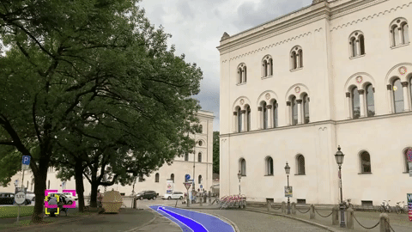
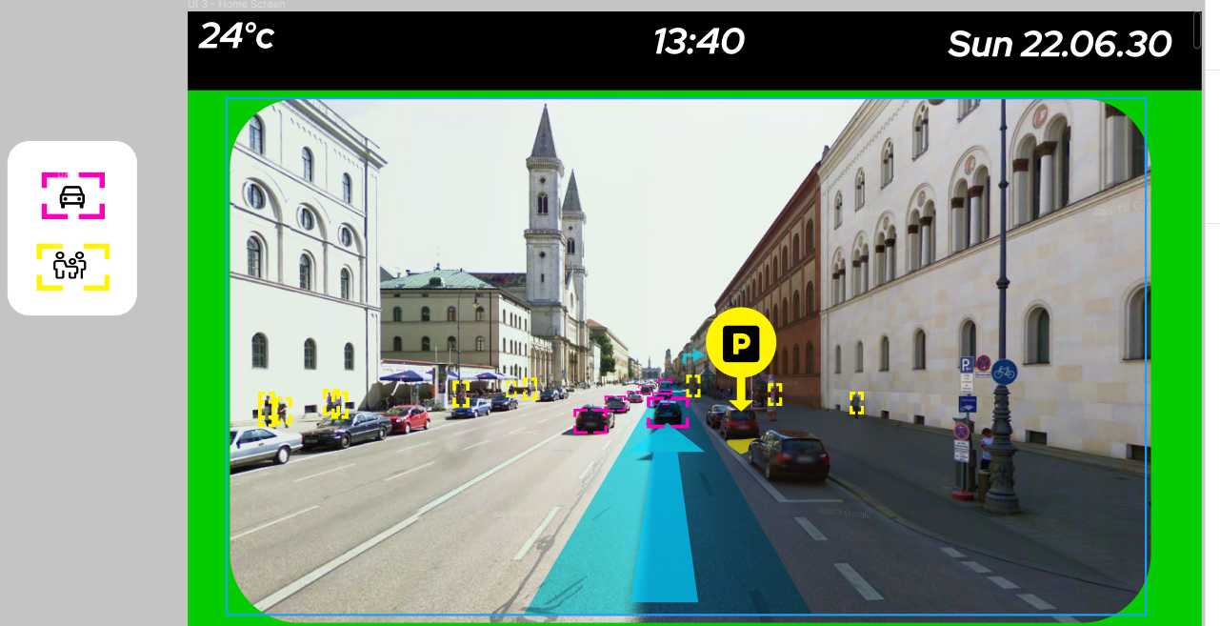
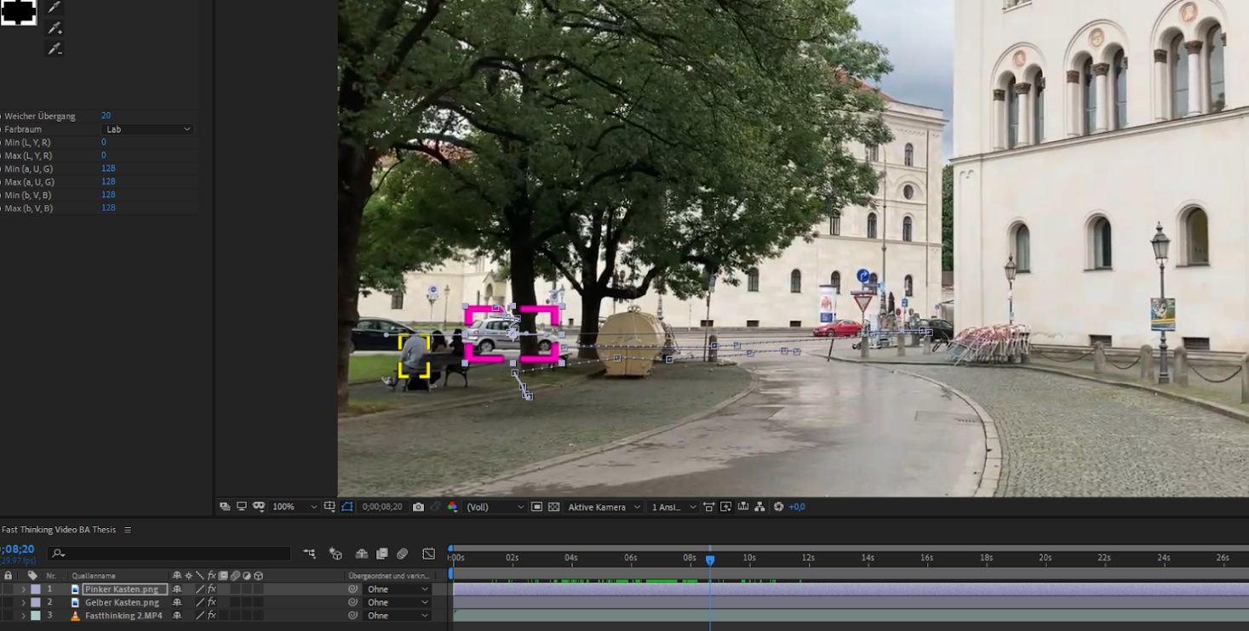
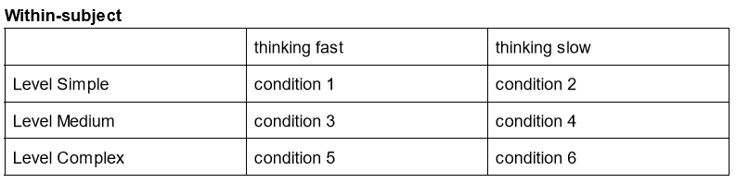
4. Concept – Pilot Study
Next Step:
2 videos of starting point (parked car, moving car)
Inserted AR visuals (Mark, Route, Arrow)
GIF loops (Figma compatible)
Parked car = Slow Thinking
Implementation of 6 Levels
FT1, FT2, FT3
ST1, ST2, ST3
Notes:
Three wireframe screens planned:
Home screen () General Car information (speed, braking or accelerating, gas/ battery status,
Navigation screen () Big map with preset route, two shops each scenario to choose from
Notification screen (Have the emoji enact) -> keep the smiley to suggest reroute, but focus on the reroute functionality
(100% of the 11 participants said
they preferred the street view over a "dark mode" or "satellite view").

Slide 15
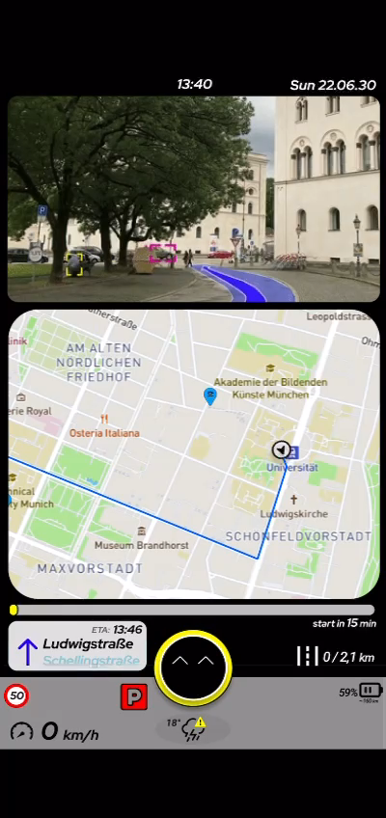
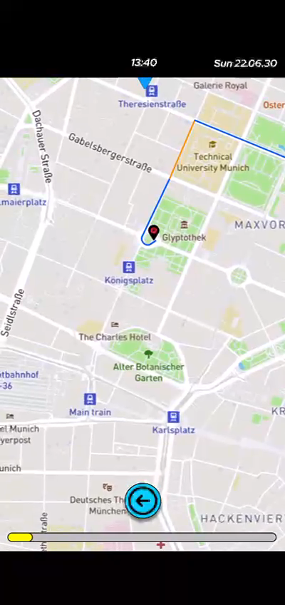
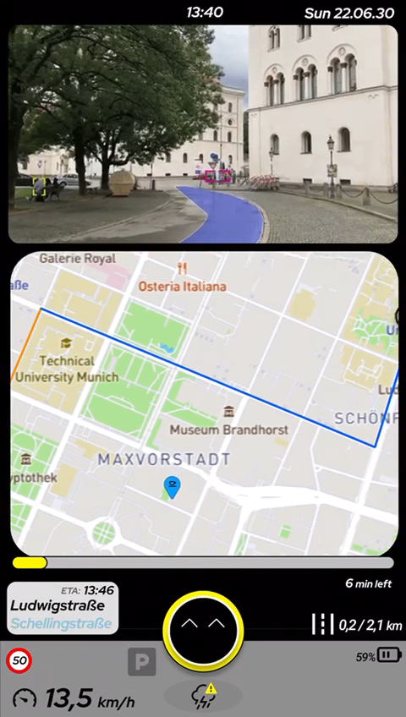
5. Implementation - Interaction
FT1
FT2
ST3
Notes:
ID 25 - Slow thinking level 3
ID 14 – Fast thinking level 2
ID 26 - Fast Thinking level 1

Slide 16
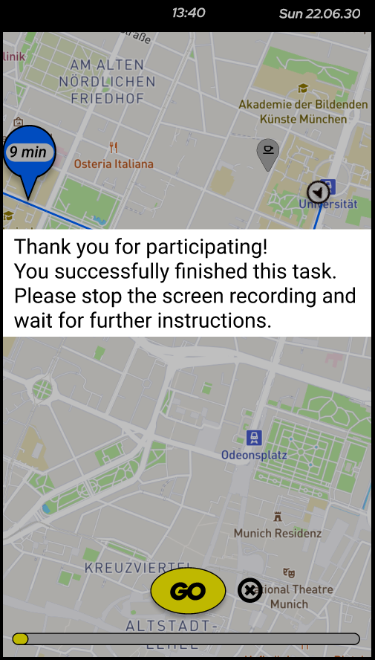
5. Implementation – Aid tools
UX design:
Design tool: “Figma”
Android/IOS application: “Figma Mirror” (remote testing)
Plan-level application
add stopover to route
Online Study:
Zoom conference & screen share
Limesurvey questionnaire
Mobile screen capture
Notes:
Design tool: “Figma”
“Figma Mirror” (remote testing, google login) same google login to upload the screen recordings after the study conduction
Plan-level application
add stopover to route
Limesurvey & mobile screen capture

Slide 17
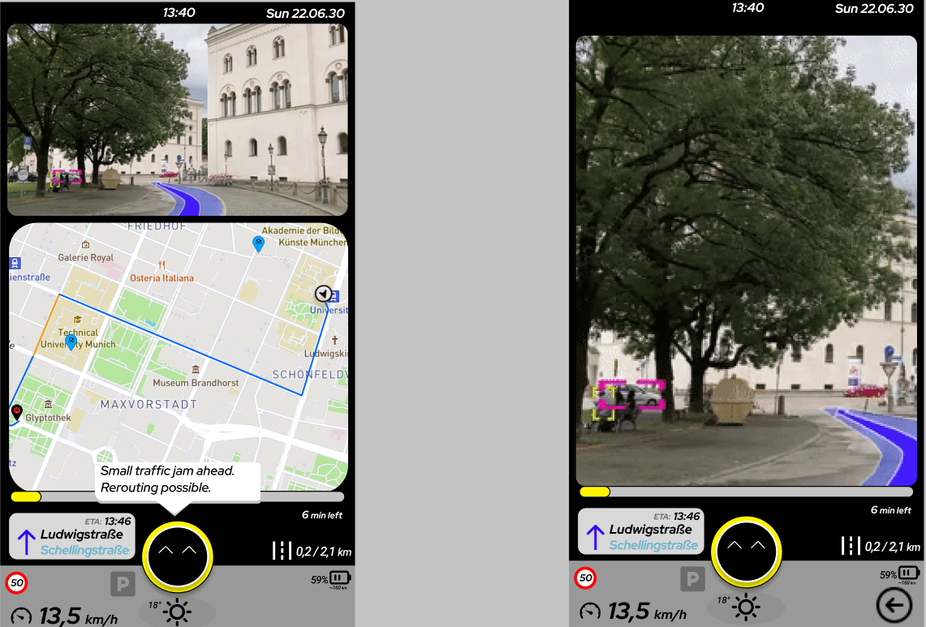
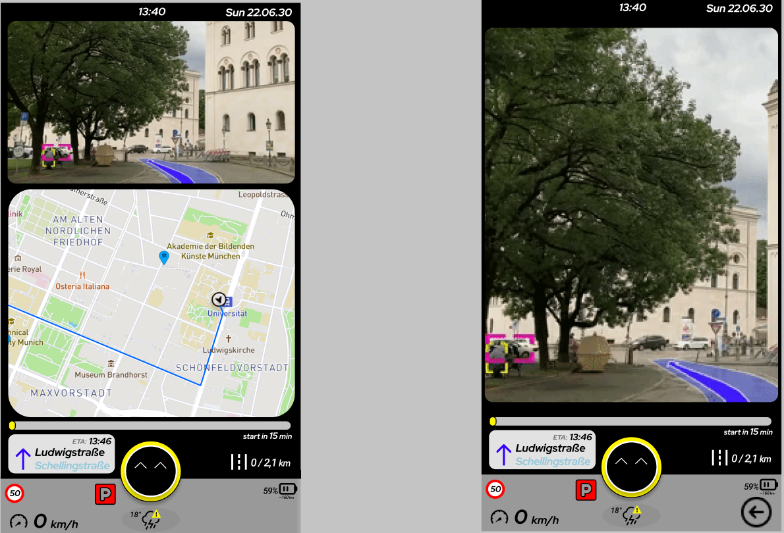
5. Implementation – Homescreen
FT3
ST3
Notes:
Level 3 complex; best one to compare since all information is displayed
Commonalities:
-Speed limit
-preset route
-level specific shop selection (ice cream, quick snack, coffee)
-Smileynotification
-battery/fuel status
-picture in picture AR components
-Weather
-street info and arrow indication
Differences:
-Time of arrival/ Time until start
-Current speed differs (parked/moving)
-Kilometres until arrival
-Parking sign (red/greyed out)
-picture and picture video footage
Use level 3 to compare the 2 scenarios

Slide 18
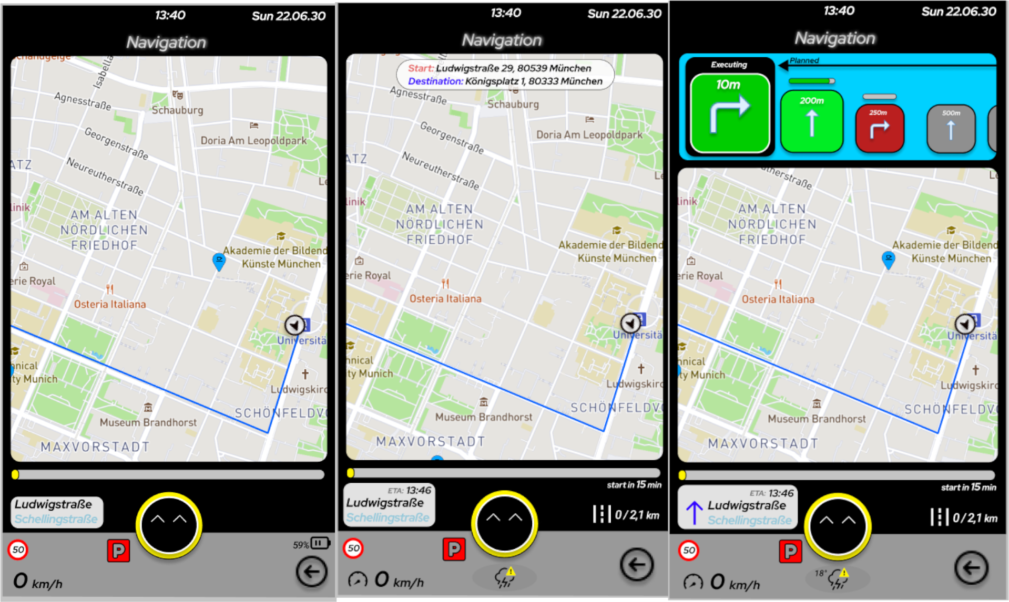
5. Implementation – Navigation
Slow Thinking Overview
Notes:
Level 3 complex; best one to compare since all information is displayed
Commonalities:
-Speed limit
-preset route
-level specific shop selection (ice cream, quick snack, coffee)
-Smileynotification
-battery/fuel status
-picture in picture AR components
-Weather
-street info and arrow indication
-progressbar
Differences:
-Time of arrival/ Time until start
-Current speed differs (parked/moving)
-Kilometres until arrival
-Parking sign (red/greyed out)
-picture and picture video footage
Use level 3 to compare the 2 scenarios

Slide 19
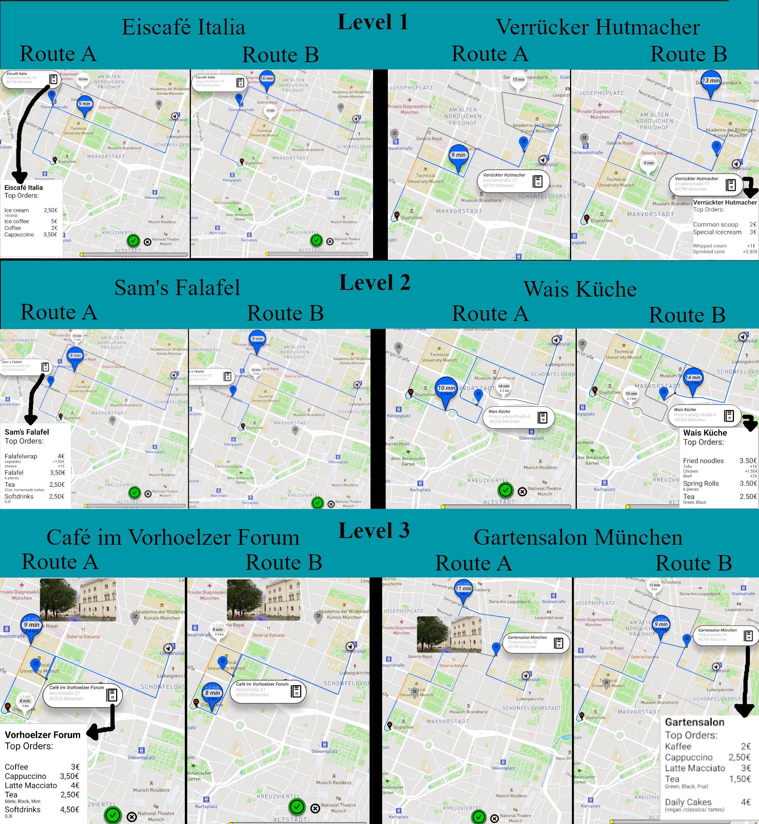
5. Implementation – Level 1
Level 1: Ice cream
2 shops
2 routes for each shop (new time of arrival (TOA))
Menu for selected shop

Slide 20
5. Implementation – Level 2
Level 2: Quick Snack
Route Information for Selection: ToA, Mins added

Slide 21
5. Implementation– Level 3
Level 3: Coffee
Route Information for Selection: ToA, Mins added, Distance in km

Slide 22
5. Implementation – Confirmation
Confirm shop and route selection by pressing „GO“
X- Button to undo previous step
Participant notifies about finished task
Recordings contains:
Time measured
Chosen location
Interaction steps
After all Levels, upload of recordings to matching ID Folder on Google Drive

Slide 23
6. Main Study – Introduction
Details:
Guided online-study on Zoom
Limesurvey questionnaire (Demographics, T0)
For each of the 3 levels:
Figma Mirror screen capture
Limesurvey questionnaire (T1, SUS, UX)
Final interview
Google drive upload
N=30 participants [9 = F, 20 = M, 1 undisclosed]
Fast Thinking (FT)
Slow Thinking (ST)
Time: 1 hour
Notes:
Demographic Questions (Age, Gender, Car Usage)
Explained scenario
Rear-seat passenger of an AV
AV is (parked/ moving)
Picture-in-picture view
Form T0 (Baseline Trust)
Perform task, answer 3 sections
Repeat 3 times
Final interview
Upload of videos
- largest group of participants belonging to the 20-29 age group (n=25, 83.33%), average age of 27.43, a standard deviation of 10.68

Slide 24
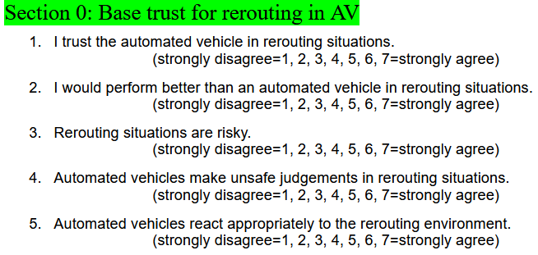
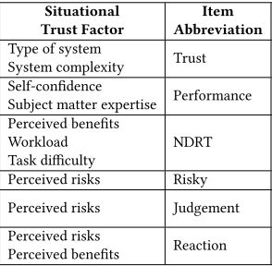
6. Concept – Measurement
Situational Trust Scale (STS) – rephrased for AV rerouting situations
Comparison between base trust T0 vs. trust after prototype T1
System Usability Scale (SUS)
10 questions to get system usablity reference
Answer after every level
Paper source: https://doi-org.emedien.ub.uni-muenchen.de/10.1145/3409120.3410637,
Holthausen, Wintersberger 2020 – Situational Trust Scale for Automated Driving (STS-AD)

Slide 25
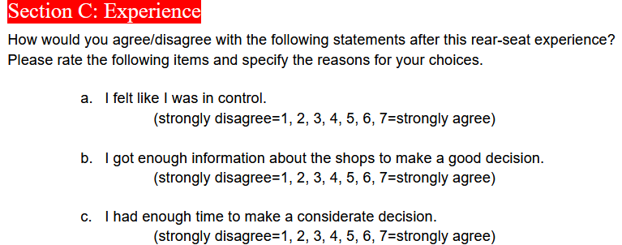
6. Concept – Measurement
3 self defined questions
Considered separately
Get rough picture if prototype fullfilled pilot study information demands
Control (C), Shop information (SI), Time (T)
Final semi-structured interview (10 Mins)

Slide 26
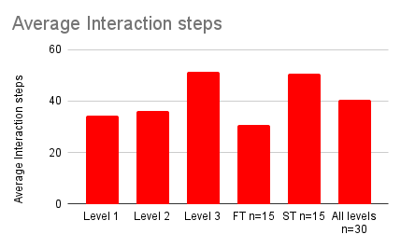
7. Results – Interaction Steps
FT group finished Task with less interaction steps than ST
FT123 Mean = 30.78, StdDev = 20.133;
ST123 Mean = 50.56, StdDev: 81.457;
[N=30] Mean = 40.67, StdDev = 59.830

Slide 27
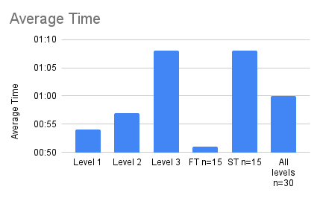
7. Results – Average Time
FT group tend to finish the tasks more quickly than ST
FT123 Mean = 00:51, StdDev: 20.134;
ST123 Mean = 01:08, StdDev: 81.457;
[N=30] Mean = 01:00, StdDev: 59.830.
Notes:
High deviation in ST is explainable,
one participant took a very long time to finish the task.
Thus the overall time also has a quite high stddev.

Slide 28
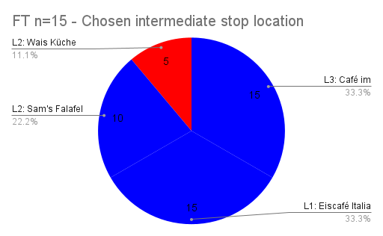
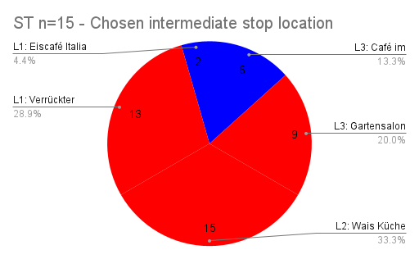
7. Results – Selected Shop
(N=21, 70%) opted for detour to level 3 shop "Café im Vorhoelzer Forum„ (closest to the destination address, route is mostly identical)
FT predominantly chose the further shop
ST predominantly chose the closer shop
= closer = further
Notes:
The data and interview feedback indicates
that the Slow Thinking(ST) group more carefully considered different factors (more time to decide, no haste) in choosing a shop
while the Fast Thinking (FT) group more often chose the shop due to their starting location (nearest shop, get the task done)
factor time pressure
position of a moving car for the
store farther away, theoretically, one has more time before the planned route must be recalibrated
For the closer store, the decision to reroute would have to be made earlier.

Slide 29
7. Results - Trust
FT-T0: Mean = 4.37, StdDev = 0.965
FT-T1: Mean = 5.83, StdDev = 0.748
ST-T0: Mean = 4.88,StdDev = 0.724
ST-T1: Mean= 5.8, StdDev = 0.752
T0-[n=30]: Mean = 4.63, StdDev = 0.877
T1-[n=30]: Mean = 5.82, StdDev = 0.746
Baseline Trust T0
Trust T1

Slide 30
7. Results - Trust
Final Interview rating:
Level 3 ranked highest
(n=21 [70%]; FT=11, ST=10)
Level 1 second ranking
(n=15 [50%]; FT=9, ST=6)
Level 2 lowest ranking
(n=14 [46.67%]; FT=9, ST=5)
Level 1 – simple highest trust rating
1-T1 Mean = 5.99, StdDev = 0.619
Level 3 – complex second highest rating
3-T1 Mean = 5.76, StdDev = 0.909
Level 2 – medium in last place
2-T1 Mean = 5.7, StdDev = 0.672).

Slide 31
7. Results - Usability
Overall score = 75.38 on a scale of 100, r=0.7538, StdDev = 15.619)
Normalised rating > 68; adjectives "good" and "excellent"
Paper source: https://dl.acm.org/doi/10.5555/2835587.2835589 Kortum Bangor 2009 - Determining What Individual SUS Scores Mean: Adding an Adjective Rating Scale
Notes:
Source for SUS

Slide 32
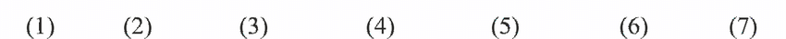
7. Results - Experience
Likert 7 scalar questions:
Control (C) = mean = 5.93, StdDev-C = 1.261
Shop Information (SI) = mean = 4.42, StdDev-SI= 1.761
Enough time to reroute (T) = mean = 5.79, StdDev-T =1.222
SI
T
C
Strongly Disagree
Disgree
Slightly
Disagree
Neutral
Slightly
Agree
Agree
Strongly
Agree
Shop information: not sufficient
Percieved control: OK
Time for NCSS: OK
Notes:
Look for likert scale the other way around

Slide 33
7. Results – Semi-Structured Interview
AV Control Interface: Hand-Held Device vs. Built-In
N=16 (53.33%) would like to interact with a built-in interface
N=14 (46.67%) would prefer to have a mobile interface
Shop filter for simpler reroute under time restraint:
Likelihood of use: Mean = 6.4, StdDev = 0.724
Comment:
Useful tool under time pressure, but room for improvement

Slide 34

7. Results – Semi-Structured Interview
Traffic camera on trust (Mostly positive, some negative)
Learning effect (Levels similar in their structure)
Too similar information split (Level 2 & 3 too similar)
Still some concerns about IT security and
Complications with mobile phones (i.e. low battery, no internet, slow-response times, device receives a call)
Improvement:
Trusted Sound Landscape
Sound cues for warnings [N=9 (30%)]
Voice control [N=7 (23.33%)]
Placement of smiley away from center (no actual help)
Shop Symbols do not always correspond to shop
Notes:
Weather Info could be left out

Slide 35
8. Conclusion
UI: Raise in trust level towards the AV in participants, especially FT
Level 3 complex first in user rank
Level 1 simple had best survey score
Time frame influences the decision making process (Interaction steps, time, location)
- Time limit for reroute can result in stress
Indecisive behavior, discomfort
- Shop filter supports time sensitive reroutes
Notes:
Three bulletpoints

Slide 36
Bachelor Thesis Bibliography
References [1] Jackie Ayoub, Feng Zhou, Shan Bao, and X. Jessie Yang. From manual driving to automated driving: A review of 10 years of autoui. In Proceedings of the 11th International Conference on Automotive User Interfaces and Interactive Vehicular Applications, AutomotiveUI ’19, pages 70–90, New York, NY, USA, 2019. Association for Computing Machinery. [2] Aaron Bangor, Philip Kortum, and James Miller. Determining what individual sus scores mean: Adding an adjective rating scale. J. Usability Studies, 4(3):114–123, 2009. [3] Melanie Berger, Aditya Dandekar, Regina Bernhaupt, and Bastian Pfleging. An ar-enabled interactive car door to extend in-car infotainment systems for rear seat passengers. In Extended Abstracts of the 2021 CHI Conference on Human Factors in Computing Systems, CHI EA ’21, New York, NY, USA, 2021. Association for Computing Machinery. [4] Amber Case. Calm technology: Principles and patterns for non-intrusive design. O’Reilly Media, Sebastopol, CA, first edition edition, 2015. [5] Anna-Katharina Frison, Philipp Wintersberger, Andreas Riener, Clemens Schartmüller, Linda Ng Boyle, Erika Miller, and Klemens Weigl. In ux we trust: Investigation of aesthetics and usability of driver-vehicle interfaces and their impact on the perception of automated driving. In Proceedings of the 2019 CHI Conference on Human Factors in Computing Systems, CHI ’19, pages 1–13, New York, NY, USA, 2019. Association for Computing Machinery. [6] Brittany E. Holthausen, Philipp Wintersberger, Bruce N. Walker, and Andreas Riener. Situational trust scale for automated driving (sts-ad): Development and initial validation. In 12th International Conference on Automotive User Interfaces and Interactive Vehicular Applications, AutomotiveUI ’20, pages 40–47, New York, NY, USA, 2020. Association for Computing Machinery. [7] Abhijai Miglani, Cyriel Diels, and Jacques Terken. Compatibility between trust and non-driving related tasks in ui design for highly and fully automated driving. In Adjunct Proceedings of the 8th International Conference on Automotive User Interfaces and Interactive Vehicular Applications, AutomotiveUI ’16 Adjunct, pages 75–80, New York, NY, USA, 2016. Association for Computing Machinery.
[8] Bastian Pfleging, Maurice Rang, and Nora Broy. Investigating user needs for non-driving-related activities during automated driving. In Proceedings of the 15th International Conference on Mobile and Ubiquitous Multimedia, MUM ’16, pages 91–99, New York, NY, USA, 2016. Association for Computing Machinery.
[9] Sonja Rümelin. The cockpit for the 21st century. [10] Sonja Rümelin, P. Siegl, and A. Butz. Could you please ... ? investigating cooperation in the car. In Adjunct Proceedings of the 5th International Conference on Automotive User Interfaces and Interactive Vehicular Applications (AutomotiveUI ’13), pages 61–64. AutomotiveUI ’13, 2013. [11] Jacques Terken and Bastian Pfleging. Toward shared control between automated vehicles and users. Automotive Innovation, 3(1):53–61, 2020. [12] Marcel Walch, Stacey Li, Ilan Mandel, David Goedicke, Natalie Friedman, and Wendy Ju. Crosswalk cooperation: A phone-integrated driver-vehicle cooperation approach to predict the crossing intentions of pedestrians in automated driving. In 12th International Conference 31 on Automotive User Interfaces and Interactive Vehicular Applications, AutomotiveUI ’20, pages 74–77, New York, NY, USA, 2020. Association for Computing Machinery. [13] Chao Wang. A framework of the non-critical spontaneous intervention in highly automated driving scenarios. In Proceedings of the 11th International Conference on Automotive User Interfaces and Interactive Vehicular Applications: Adjunct Proceedings, AutomotiveUI ’19, pages 421–426, New York, NY, USA, 2019. Association for Computing Machinery. [14] Chao Wang, Matti Krüger, and Christiane B. Wiebel-Herboth. “watch out!”: Prediction-level intervention for automated driving. In 12th International Conference on Automotive User Interfaces and Interactive Vehicular Applications, AutomotiveUI ’20, pages 169–180, New York, NY, USA, 2020. Association for Computing Machinery. [15] Philipp Wintersberger, Hannah Nicklas, Thomas Martlbauer, Stephan Hammer, and Andreas Riener. Explainable automation: Personalized and adaptive uis to foster trust and understanding of driving automation systems. In 12th International Conference on Automotive User Interfaces and Interactive Vehicular Applications, AutomotiveUI ’20, pages 252–261, New York, NY, USA, 2020. Association for Computing Machinery.
Notes:
Three bulletpoints

Slide 37
Future work:
Soundscape for subtle but meaningful notification
Voice control/ assistance
Shop filter questions
In-car or simulator testing
Better shop information
Limitations:
Hardly realistic (online study)
Figma functionalities (no zoom in, no sound, no haptic feedback)
Mostly young participants with technological preknowledge and trust
Notes:
Three bulletpoints

Slide 38
Participants car usage
13 participants ( 43.33%) reported travelling weekly as a passenger in a car
1 ( 36.67 %) reported monthly
4 (13.33%) daily
2 (6.67 %) rarely
11 (36,67%) participants average trip duration of 1-2 hours
8 (26,67 %) a duration of 30 minutes-1 hour
7 (23,33 %) a duration of less than 30minutes
4 (13,33 %) a duration of 3-5 hours per trip
Not all participants wanted to disclose their travel behaviour
Notes:
Three bulletpoints

Slide 39

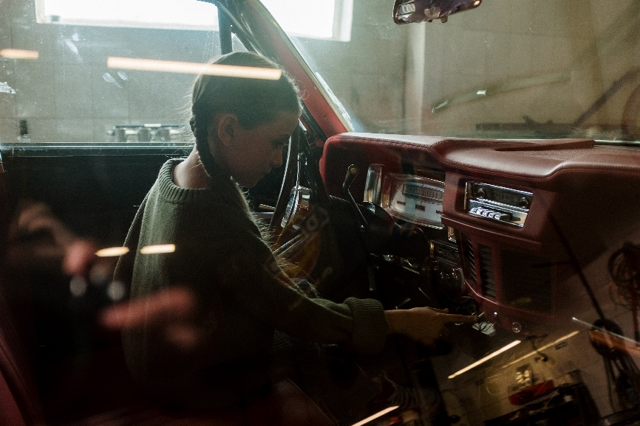
1. Introduction
User aspect :
Passengers requested stops by telling driver
NDRA vs. Situational awareness
Create sit. awareness in rear-seat?
Girl in car: https://www.pexels.com/de-de/foto/madchen-auto-fahrzeug-vintage-4481930/
Add stops to Waymo: https://lh3.googleusercontent.com/ND9wyPE8NI_XLym5a5HN6bK_bhpq-U0j5kO1jdyNLTtL2cbRBIrb4zomQq_4DgRgP8OJOpjTjYPS10vVU_zEa8kseBTMJy8A_XjyIQ=rw-w2880-e365
Notes:
User Aspect:
-Shifting UX requirements for user interaction in automated vehicles
->conventional car travel, mid-drive communication
Non driving related activities will lower the situational awareness
How do we keep the awareness high enough whilst allowing the passenger to engage in a NDRA?
Is the passenger willing to cooperate? Does the passenger trust the autonomous driving system?
New technology can cause trust issues due unknown system limitations ect.
Need for safety, autonomy (would you send your child to school in one of those cars?)
-focus of research:
investigate effects of UX on the passenger's perception of their safety and autonomy by control the AV with their phones
How do participants interact with the prototype?
Does it help to improve baseline trust issues in time sensitive cases?

